Slide 1
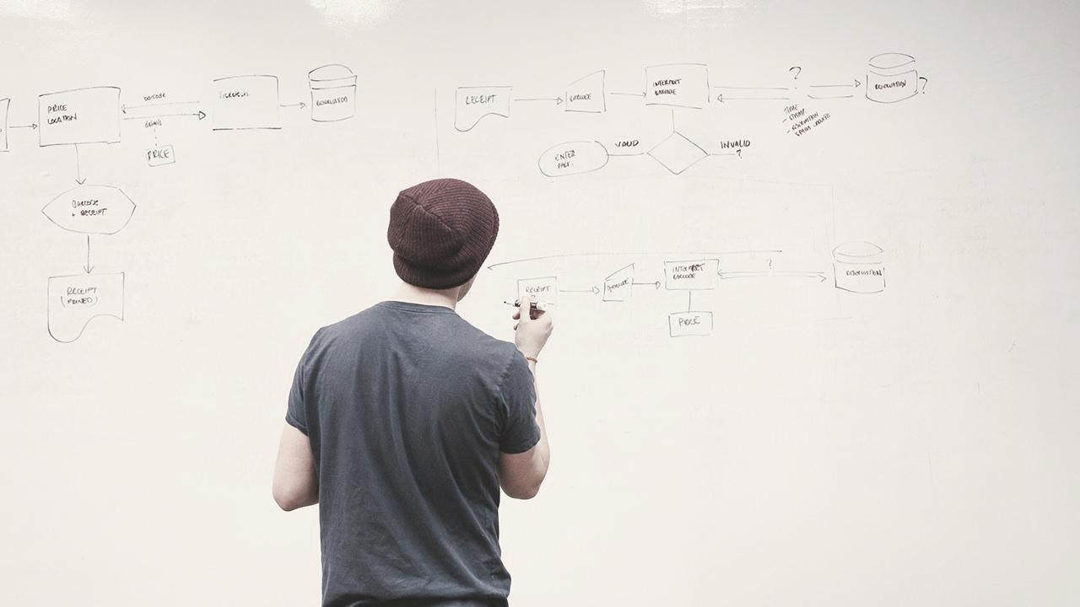

HELLO!
1
1
1
1
1
1
Our process is easy
I am <nome>
I am here because I love to give presentations.
You can find me at @username

Slide 2
BIG CONCEPT
2
2
2
2
2
2
Bring the attention of your audience over a key concept using icons or illustrations

Slide 3
You can also split your content
3
3
3
3
3
3
White
Is the color of milk and fresh snow, the color produced by the combination of all the colors of the visible spectrum.
Black
Is the color of coal, ebony, and of outer space. It is the darkest color, the result of the absence of or complete absorption of light.

Slide 4
In two or three columns
4
4
4
4
4
4
4
Yellow
Is the color of gold, butter and ripe lemons. In the spectrum of visible light, yellow is found between green and orange.
Blue
Is the colour of the clear sky and the deep sea. It is located between violet and green on the optical spectrum.
Red
Is the color of blood, and because of this it has historically been associated with sacrifice, danger and courage.

Slide 5
Let’s review some concepts
5
5
5
5
Yellow
Is the color of gold, butter and ripe lemons. In the spectrum of visible light, yellow is found between green and orange.
Blue
Is the colour of the clear sky and the deep sea. It is located between violet and green on the optical spectrum.
Red
Is the color of blood, and because of this it has historically been associated with sacrifice, danger and courage.
Yellow
Is the color of gold, butter and ripe lemons. In the spectrum of visible light, yellow is found between green and orange.
Blue
Is the colour of the clear sky and the deep sea. It is located between violet and green on the optical spectrum.
Red
Is the color of blood, and because of this it has historically been associated with sacrifice, danger and courage.

Slide 6
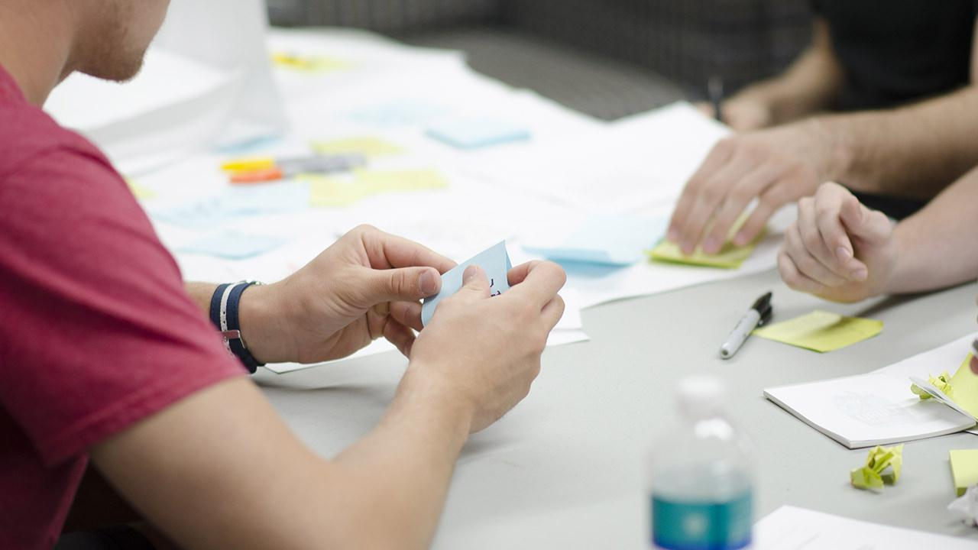
A picture is worth a thousand words
6
6
6
6
6
6
A complex idea can be conveyed with just a single still image, namely making it possible to absorb large amounts of data quickly.

Slide 7
Use charts to explain your ideas
7
7
7
7
7
7
White
Gray
Black

Slide 8

8

Slide 9

9
Qualidade
Entrada Demanda
Qualidade
Metodologia
Distribuição
/Testes
Disponibilidade de Recursos
Cenário/Controle de testes
Entender especificações
Codificar Programa
Linha de Produção
Executar testes Unitários
Gerar Evidências
Entrega testes Unitários
Testes
Executar Testes
Gerar Evidências
Build/ Deploy
Montar Pacotes
Liberar Pacotes
Gerenciamento

Slide 10
10
Qualidade
Entrada Demanda
Distribuição Demandas / Processo Testes
Linha de Produção
Testes
Gerenciameno
Processos
Metodologia
Ferramentas

Slide 11
11
Qualidade
Linha de Produção
Distribuição Demandas / Processo Testes
Entrada Demanda
Testes
Gerenciamento
Processos
Metodologia
Ferramentas

Slide 12


Slide 13
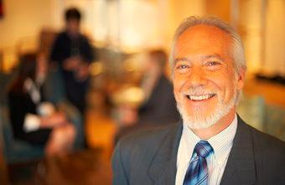

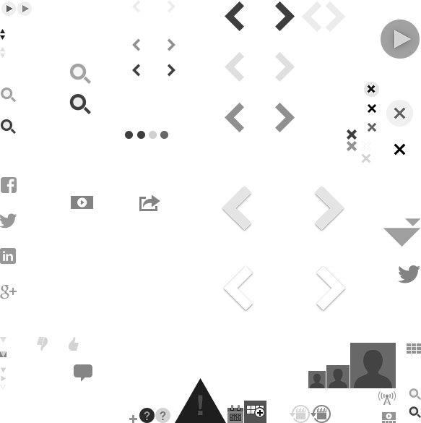

Slide 14

Want big impact? USE BIG IMAGE
Texto texto texto texto texto texto texto texto texto texto texto
Texto texto texto texto texto texto texto
texto texto texto texto texto texto texto texto texto texto texto texto texto
texto texto texto texto texto texto
1
2
3
4

Slide 15
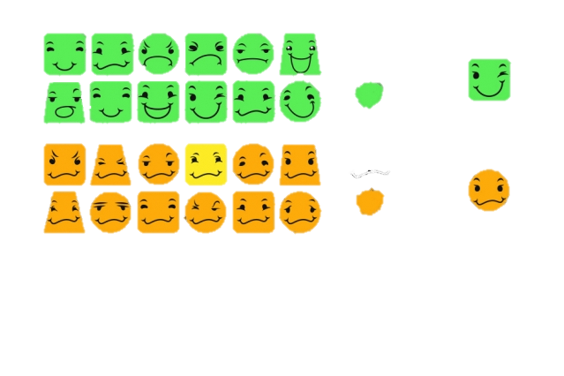
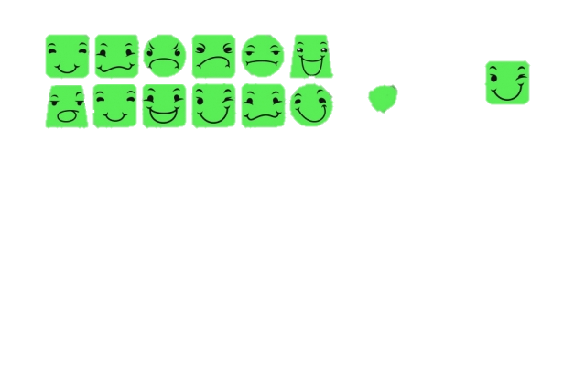
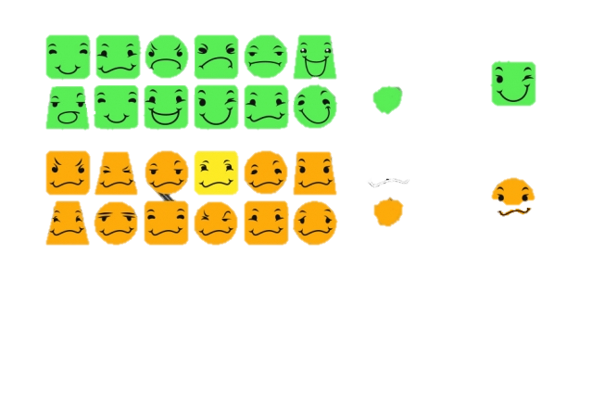
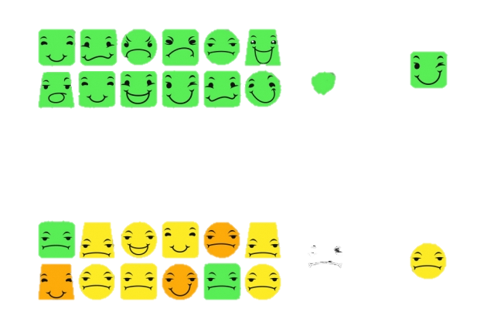
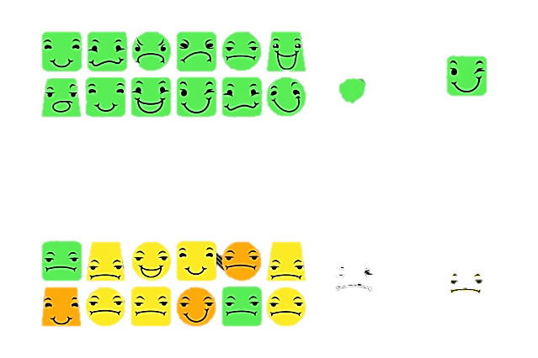

MACHINE LEARNING
------------------------------------------------------------------------------------------------
------------------------------------------------------------------------------------------------
Aprendizagem automática é um ramo da inteligência artificial cujo objetivo é desenvolver técnicas que permitam o computador aprender a partir de exemplos e observações

Slide 16

MACHINE LEARNING
16
16

Slide 17



17

Slide 19





19
👤
Home Empresa Notícias Serviços Produtos Fale conosco
NOME
👤
EMAIL
Belo Horizonte / Nova Lima – MG Alameda da Serra, 891 – Sala 708 Vila da Serra Cep 34000-000
Tel.: (31) 3505-1940 Fax: (31) 3505-1901
ASSUNTO
MENSAGEM
Estamos aqui
Conectar ao:
Gmail
Facebook
Enviar

Slide 20
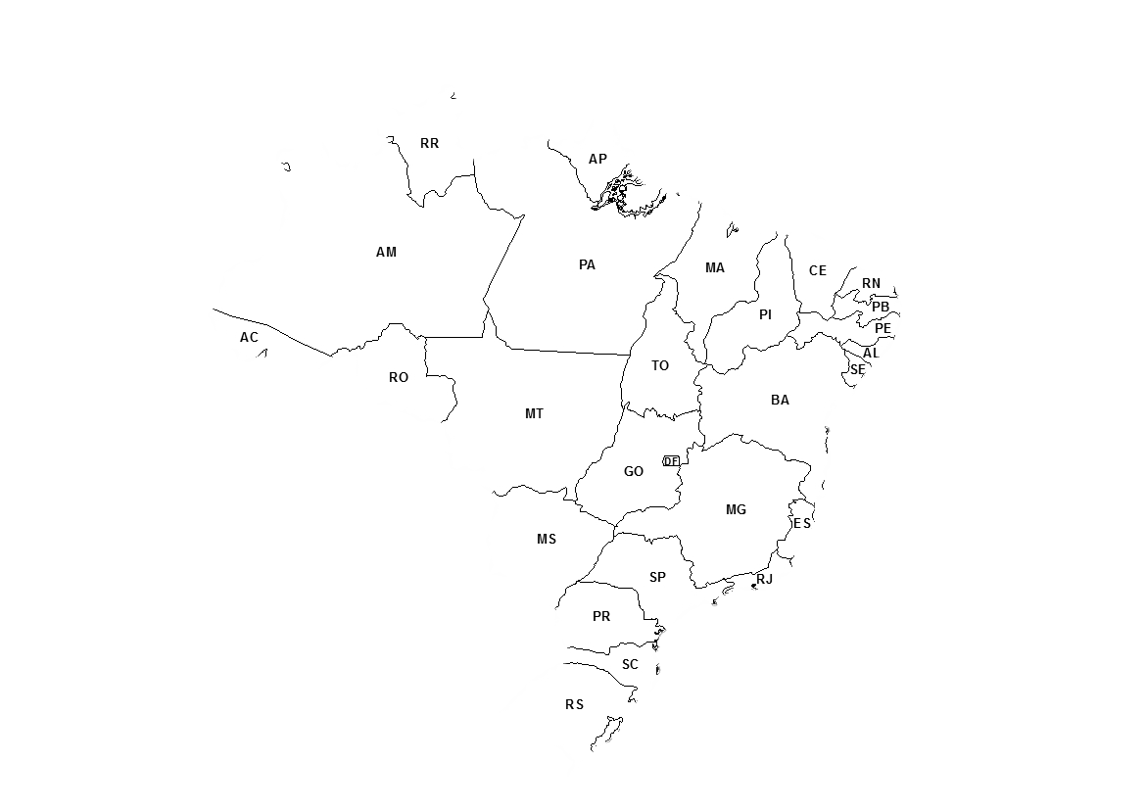
Maps
20
20
20
20
20
our office

Slide 21
89,526,124
21
21
21
21
21
Whoa! That’s a big number, aren’t you proud?

Slide 22
89,526,124$
185,244 users
100%
22
22
22
22
22
That’s a lot of money
And a lot of users
Total success!

Slide 23
Our process is easy
23
23
23
23
23
first
second
last

Slide 24
24
24
24
ANDROID PROJECT
Show and explain your web, app or software projects using these gadget templates.
Place your screenshot here

Slide 25
25
25
25
iPHONE
PROJECT
Show and explain your web, app or software projects using these gadget templates.
Place your screenshot here

Slide 26
26
26
26
TABLET
PROJECT
Show and explain your web, app or software projects using these gadget templates.
Place your screenshot here

Slide 27
27
27
27
DESKTOP PROJECT
Show and explain your web, app or software projects using these gadget templates.
Place your screenshot here

Slide 28
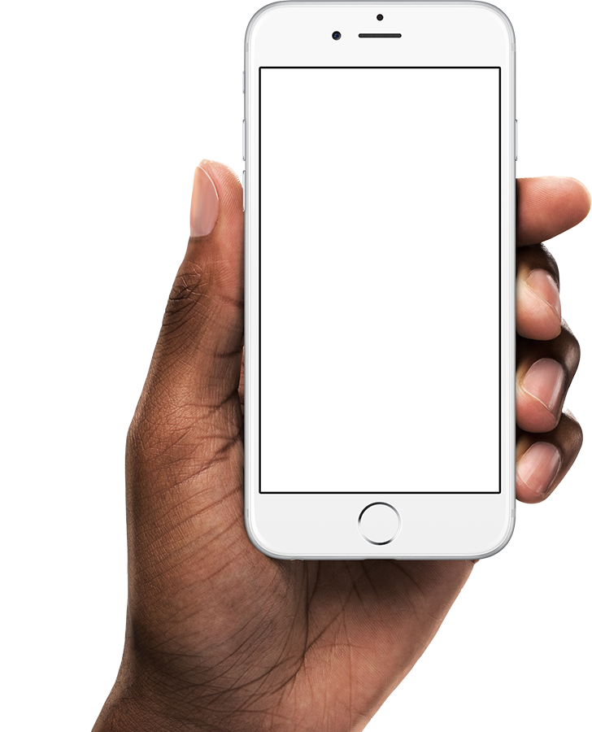
28

Slide 29
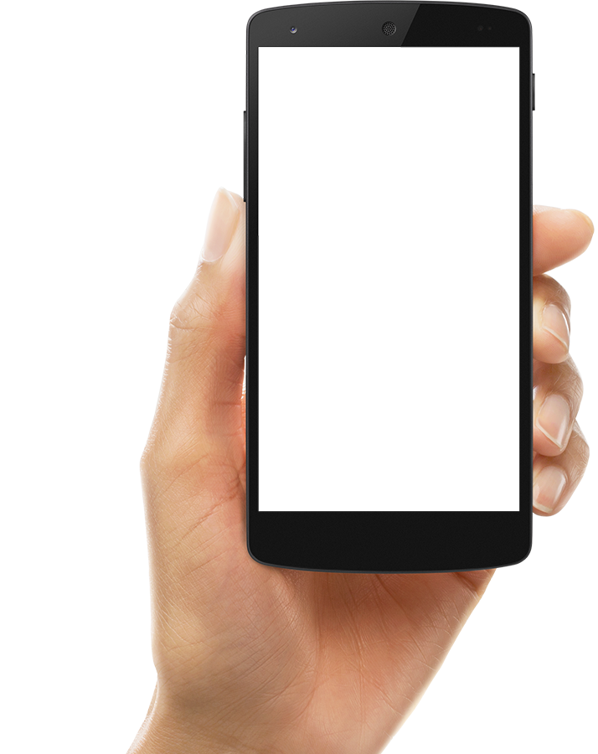
29

Slide 30
30
30
30
SlidesCarnival icons are editable shapes.
This means that you can:
Resize them without losing quality.
Change line color, width and style.
Isn’t that nice? :)
Examples:

Slide 31
31
31
😉
Texto texto texto texto texto texto texto texto texto texto texto texto texto texto texto texto texto texto texto texto texto
texto texto texto texto texto texto texto texto texto texto texto texto texto texto texto texto texto texto texto
✋👆👉👍👤👦👧👨👩👪💃🏃💑❤😂😉😋😒😭👶😸🐟🍒🍔💣📌📖🔨🎃🎈🎨🏈🏰🌏🔌🔑 and many more...

